Slide 1
Network Measurement
Types of Network Data

Slide 2
Where does network data come from?
Surveys
  You ask people about their relations
    Best approach for the collection of ego network data
      Next class!
Direct Observation
  You go to a site and record interactions between people
    Classrooms
    Neighborhoods
    Karate Club
    Monastery
    Frat House
    Beach?

Slide 3
Where does network data come from?
Archives
  You find independent records recording the (direct or indirect) relations between people
    Old Fashioned
      Organizational rosters recording common memberships
      Letters or other snail-type correspondence
    Newfangled
      Email logs
      Electronic communications logs (e.g. texts, calls, snapchat, messenger)
      Social media (e.g. Facebook, twitter, instagram)
      Dating websites (e.g. OK Cupid, Tinder, Grindr)
      Virtual memberships (e.g. chat boards, newsgroups)
      Electronic consumption records (e.g. Amazon, Reddit, Netflix, Imgur, etc.)
      Blogs and electronic journals

Slide 4
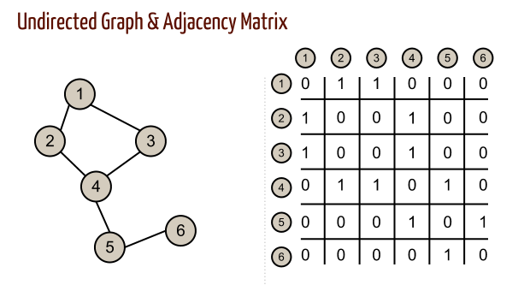
How do you store network data?
First: Give each vertex in the network a unique identifier!
  Usually consecutive integers:
    1, 2, 3...N
Second: Pick a storage format
  Adjacency Matrices
    Fine for small to medium size networks
    Gets cumbersome for large, sparse networks

Slide 5
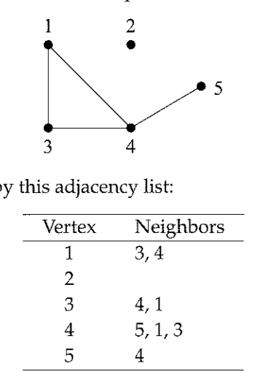
How do you store network data?
First: Give each vertex in the network a unique identifier!
  Usually consecutive integers:
    1, 2, 3...N
Second: Pick a storage format
  Adjacency Lists
    More efficient for large, sparse networks
    Can be used in traditional statistical packages

Slide 6
How do you store network data?
First: Give each vertex in the network a unique identifier!
  Usually consecutive integers:
    1, 2, 3...N
Second: Pick a storage format
  Adjacency Lists
    More efficient for large, sparse networks
    Can be used to also store vertex properties

Slide 7
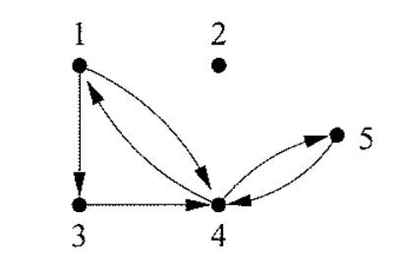
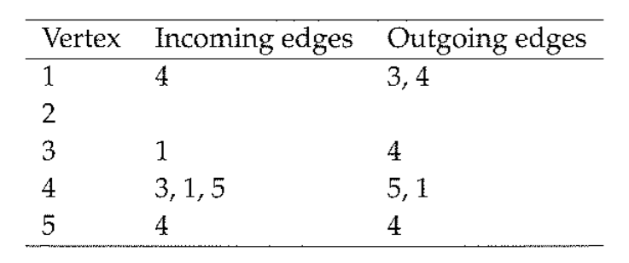
How do you store network data?
First: Give each vertex in the network a unique identifier!
  Usually consecutive integers:
    1, 2, 3...N
Second: Pick a storage format
  Adjacency Lists
    More efficient for large, sparse networks
    Can be used to also store vertex properties
    Can be used to store undirected and directed networks

Slide 8
How do you store network data?
First: Give each vertex in the network a unique identifier!
  Usually consecutive integers:
    1, 2, 3...N
Second: Pick a storage format
  Edge List
    Most convenient and space-efficient way to store network data
    Vertex properties must be stored elsewhere
Edge List
1,3
1,4
3,4
4,1
4,5
5,4

